Slide 1


CS 235: User Interface Design February 12 Class Meeting
Department of Computer Science San Jose State University Spring 2015 Instructor: Ron Mak
www.cs.sjsu.edu/~mak

Slide 2
Your Application Prototype
Each team should build a working prototype of its application.
Concentrate on designing a good user interface.
Use UI design patterns.
The prototype doesn’t have to really work.
“Fake it” enough so that looks realistic.
Hard-code the interactions.
OK for some execution paths not to work at all.
Make at least two of your use cases “work”.
Concentrate on designing a good user experience.

Slide 3
Your Application Prototype, cont’d
Bob Nicholson’s favorite wireframe tool:
Balsamic Mockups
https://balsamiq.com
You will perform usability testing with your application prototypes.
Determine how good your UI and UX designs are.
We will study how to perform usability testing starting next week.

Slide 4
Organization Design Patterns
Feature, Search, and Browse
News Stream
Picture Manager
Dashboard
Canvas + Palette
Wizard
Settings Editor
Alternate Views
Multiple Workspaces
Multilevel Help

Slide 5
Navigation Design Patterns
Clear Entry Points
Hub and Spoke
Fully Connected
Multilevel
Sequential
Pyramid
Pan and Zoom
Modal Dialog
Escape Hatch
Bookmark

Slide 6
Page Layout Design Patterns
Visual Framework
Center Stage
Grid of Equals
Tiled Sections
Module Tabs
Collapsible Panel
Movable Panels
Left-right Alignment
Responsive Enabling
Self-adjusting Layout

Slide 7
List Design Patterns
Two-panel Selector
One-Window Drilldown
List Inlay
Thumbnail Grid
Carousel
Striped Rows
Pagination
Jump to Item
Alphabet Scroller
Cascading Lists
Tree Table
New-Item Row

Slide 8
Action Controls
Buttons
Menu bars
Pop-up menus
Drop-down menus
Toolbars
Links
Action panels
Hover tools
Double-clicking
Keyboard actions
Drag-and-drop
Typed commands

Slide 9
Action Design Patterns
Ways to present action.
Indicate progress of actions.
Give users a sense of closure.
Allow users to preview actions.
Allow users to cancel actions.
Allow users to undo actions. _

Slide 10
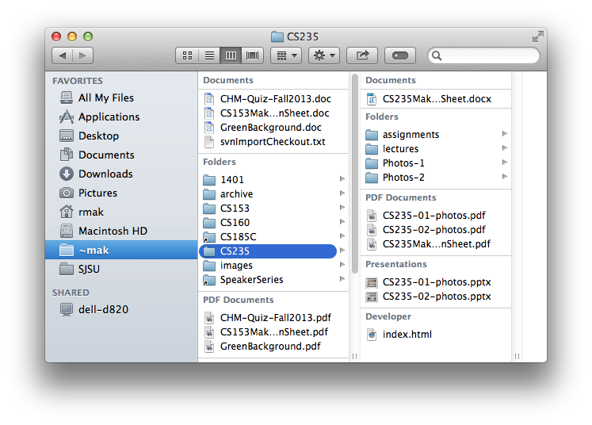
Action: Button Groups
What
Group related actions
Multiple groups for multiple sets of actions
When
Many possible actions
Related sets of actions
Why
Gestalt principles
Actions that can take place in a given context
Button clusters easy to pick out among in a complex layout

Slide 11
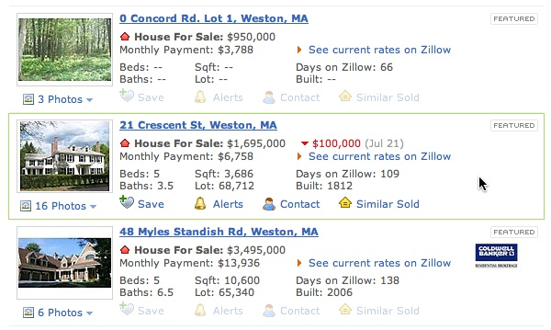
Action: Hover Tools
What
Place controls next to the item they act upon
Hide or disable the controls until the user hovers the mouse over the item
When
Many possible actions
Keep user interface as uncluttered as possible
Why
Show or enable only relevant controls
Designing Interfaces, 2nd ed.
by Jenifer Tidwell
O’Reilly Media, 2011

Slide 12
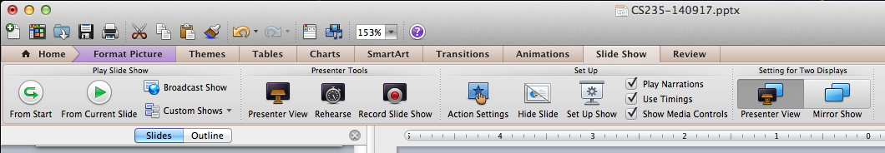
Action: Action Panel
What
A panel of related controls that is richly organized and always visible
When
The controls need to be visible always
Sufficient space to display the controls
Why
Users will always know what actions are available

Slide 13
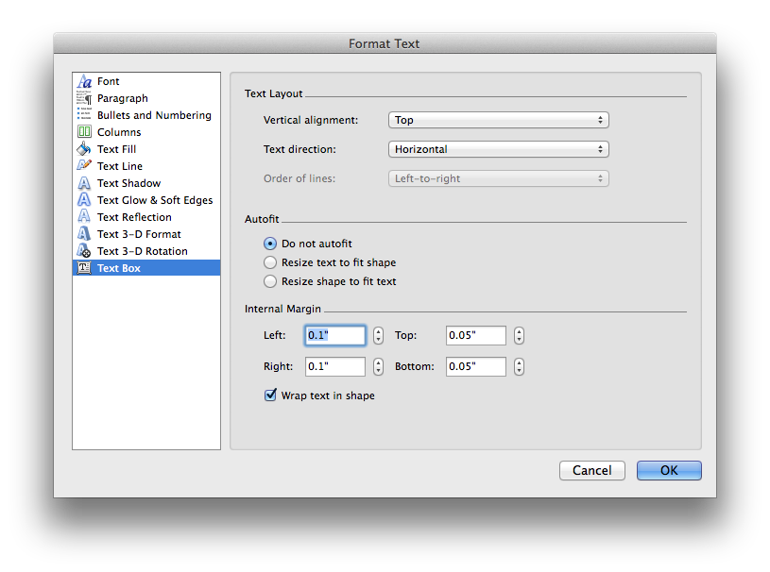
Action: Prominent “Done” Button
What
Place the button that completes an action prominently at the end of the visual flow
When
Whenever you need a Done, Submit, OK, or Continue button
Why
Give the user a sense of closure
The user knows that an action was done

Slide 14
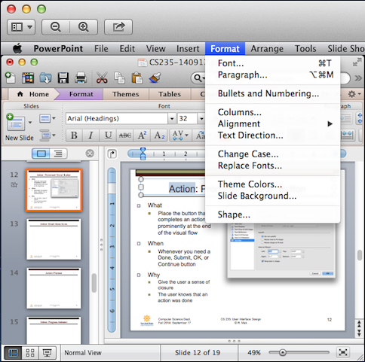
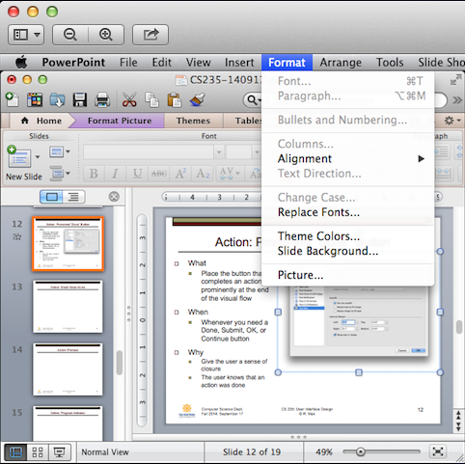
Action: Smart Menu Items
What
Dynamically change or disable menu items
When
Different actions for different contexts
Why
Only show actions that are relevant for a given context, such as a user selection

Slide 15
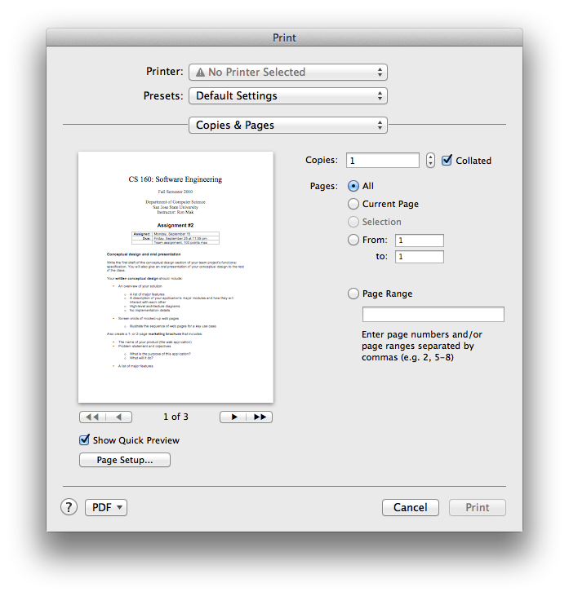
Action: Preview
What
Show a preview or summary of the results of a pending action
When
The user is about to perform an action that will produce results
Why
Assure the user that the results will be correct
Help prevent errors

Slide 16
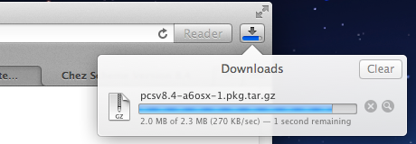
Action: Progress Indicator
What
Show how much progress a time- consuming action has made
When
A time-consuming action runs in the background
Why
Assure the user that progress is being made
Indicate how much work remains

Slide 17
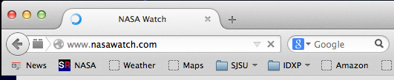
Action: Cancelability
What
Provide a way to cancel a time- consuming action
When
A time-consuming action runs in the background
Why
Users change their minds
A user wants to terminate a time-consuming action

Slide 18
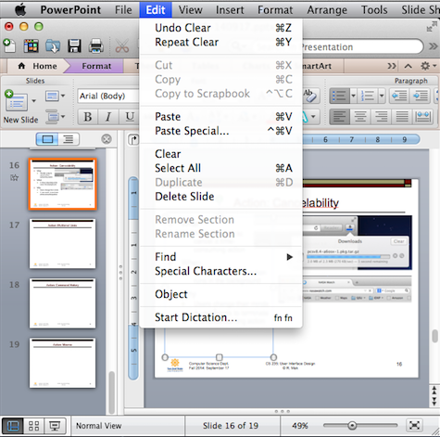
Action: Multilevel Undo
What
Allow the user to reverse a sequence of actions
When
A highly interactive interface with many user actions
Why
Provide an interface that is safe to explore
Users are confident that errors aren’t permanent
No need to “checkpoint” data and revert to an earlier version

Slide 19
Actions Generally Undoable
Text entry
Drawing changes
Layout changes
Creation, deletion, or rearrangement of items
Cut, copy, or paste operations
File operations: create, delete, rename
Database operations

Slide 20
Actions Generally Not Undoable
Navigation between pages or windows
Mouse or text cursor movements
Scrollbar position
Window or panel positions and sizes
Changes made in a modal dialog box

Slide 21
Principles of Getting Input from Users
Make sure the user understands what’s asked for and why.
If possible, don’t ask.
Give the user a list of options.
Give meaningful and sensible error messages.
Be forgiving.
Be aware of users’ mental models.
The choice of input controls determine the user’s expectations of what is asked for.
Do lots of usability testing.

Slide 22

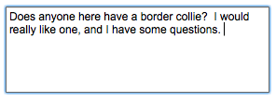

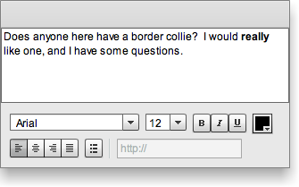
Text Input Controls
Single-line text
Multiline text
Structured text
Text editor
Designing Interfaces, 2nd ed.
by Jenifer Tidwell
O’Reilly Media, 2011

Slide 23




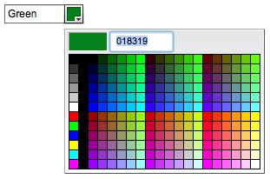
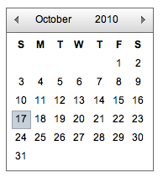
Choice Controls
Checkbox
Spinner
Radio buttons
Slider
Toggle buttons
Dropdown chooser
Calendar chooser
Designing Interfaces, 2nd ed.
by Jenifer Tidwell
O’Reilly Media, 2011

Slide 24
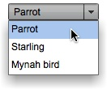
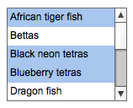
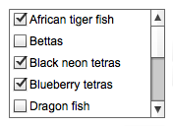
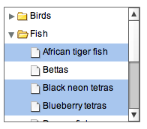
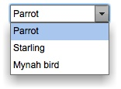
Controls for List Item Selection
Dropdown list
Multiple selection list
Checkbox list
Combo box
Multiple selection tree
Designing Interfaces, 2nd ed.
by Jenifer Tidwell
O’Reilly Media, 2011

Slide 25
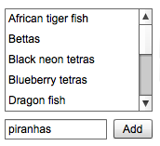
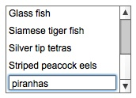
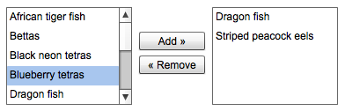
Controls for Creating Lists
List with new-item row
List with add button
List builder
Designing Interfaces, 2nd ed.
by Jenifer Tidwell
O’Reilly Media, 2011

Slide 26
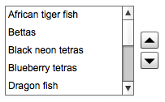
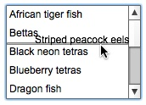
Controls for Sorting Lists
List with up-down buttons
List with internal drag-and-drop
Designing Interfaces, 2nd ed.
by Jenifer Tidwell
O’Reilly Media, 2011

Slide 27
User Input Design Patterns
Allow users to select from choices.
Allow users to input text. _

Slide 28

Input: Forgiving Format
What
An input text field that allows a variety of input formats and syntax
When
The user needs to enter information that can be typed in a variety of ways
Why
Users are unpredictable
Friendlier for users
Designing Interfaces, 2nd ed.
by Jenifer Tidwell
O’Reilly Media, 2011

Slide 29

Input: Structured Format
What
A set of text input fields that reflect the structure of the requested data
When
Input data must have a fixed structure
Why
Provide a clue to users
Reduce data entry errors
Credit card number:
Designing Interfaces, 2nd ed.
by Jenifer Tidwell
O’Reilly Media, 2011

Slide 30

Input: Fill-in-the-Blanks
What
A sentence or phrase with one or more “blanks” for the user to fill in
When
User input is in several related parts
Why
Self-explanatory interface
Hints to the user
Designing Interfaces, 2nd ed.
by Jenifer Tidwell
O’Reilly Media, 2011

Slide 31
Input: Tips and Hints
What
Explanatory text that provides tips or hints about the desired input
When
A form with a variety of input fields
Why
Tell users what input is desired
Users don’t need to consult documentation

Slide 32
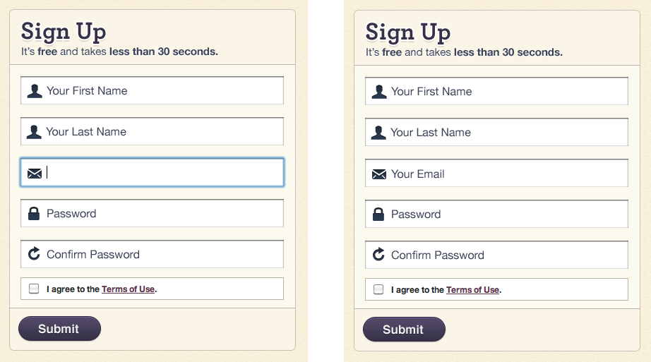
Input: Prompting Text Field
What
Text input fields pre-filled with user prompts
When
A form with a variety of input fields
Why
Tell users what input is desired
Users don’t need to consult documentation
Designing Interfaces, 2nd ed.
by Jenifer Tidwell
O’Reilly Media, 2011

Slide 33
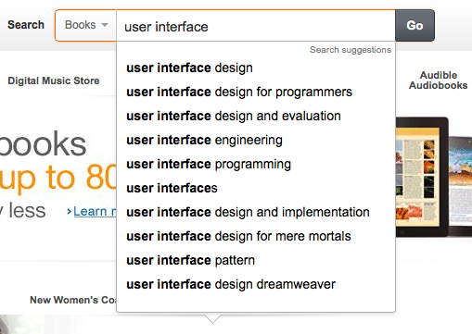
Input: Auto-Completion
What
Anticipate possible input data based on what the user has already typed
When
A list of possible ways to complete the input
Why
User-friendly time saver
Users don’t have to remember long input
Users can reuse previous input

Slide 34
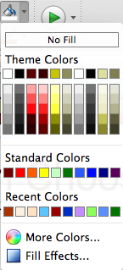
Input: Dropdown Chooser
What
A dropdown menu with a variety of items
Different ways to display the items
When
The user must choose from a set of items
Why
Users are already familiar with dropdown menus
Compact way to present menu items
Display menu items only when needed

Slide 35
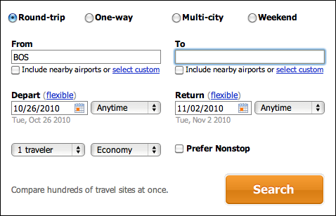
Input: Good Defaults
What
Pre-fill input fields with likely user input
When
Reasonable guesses of what the user will enter
Why
User-friendly time-saver
Less knowledge required by the user
Designing Interfaces, 2nd ed.
by Jenifer Tidwell
O’Reilly Media, 2011

Slide 36
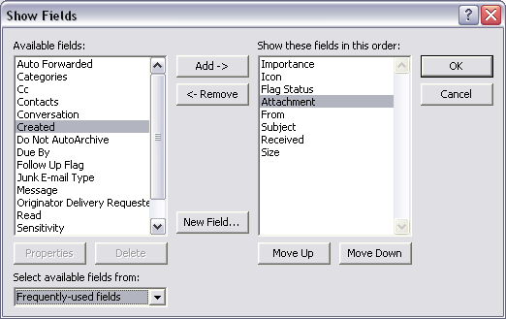
Input: List Builder
What
Source and destination lists
Add and Remove buttons, or drag-and- drop between the lists
When
The user must create a list using items from another list
Why
The user can see the available choices for the destination list
Clear what the destination list will be
Designing Interfaces, 2nd ed.
by Jenifer Tidwell
O’Reilly Media, 2011

Slide 37
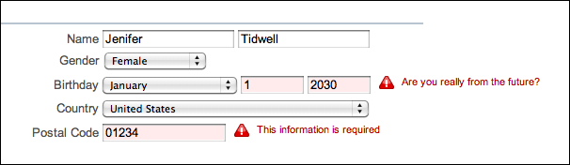
Input: Same-Page Error Messages
What
Display error messages on the same page
Display error messages next to the erroneous input
When
User might enter bad input
Why
Immediate feedback near the erroneous input
Designing Interfaces, 2nd ed.
by Jenifer Tidwell
O’Reilly Media, 2011

